Slide 1

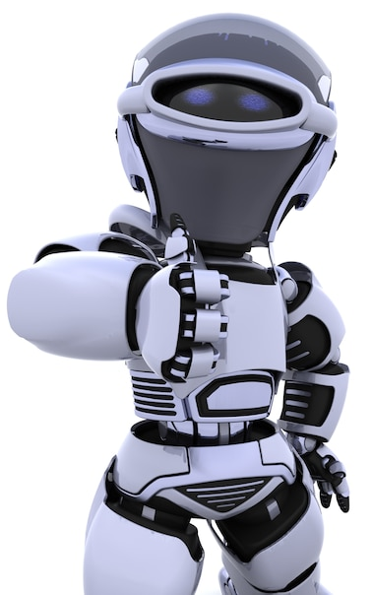
Artificial Intelligence – 30 Days Challenge - தமிழ்
Basic Intro to Python | Exploring Various Platforms
Installing Python IDLE | Setting Environmental Variable
DAY 2 / 30

Slide 2
Prerequisites for this Course
Laptop with Good Internet
No basic knowledge is required.
Note & Pen

Slide 3

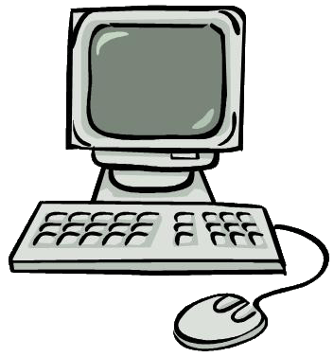
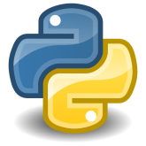
Programming Language
What is Programming Language.?
Communicate with Machine
01000001

Slide 4
INTRODUCTION
Python is a general purpose programming language created by Guido van Rossum
The language created in 1991
Python got its name for BBC comedy series from sevanties- “Monty python's flying Circus”
Python supports both procedural and object oriented programming approaches

Slide 5
Programming Language
Types
Low Level
High Level
C
C++
Java
Python
Machine languages
Assembly languages, etc.,

Slide 6

Python
Compiler
SOURCE CODE
COMPILER
MACINE CODE
OUTPUT
INTERPRETER
SOURCE CODE
COMPILER
OUTPUT

Slide 7
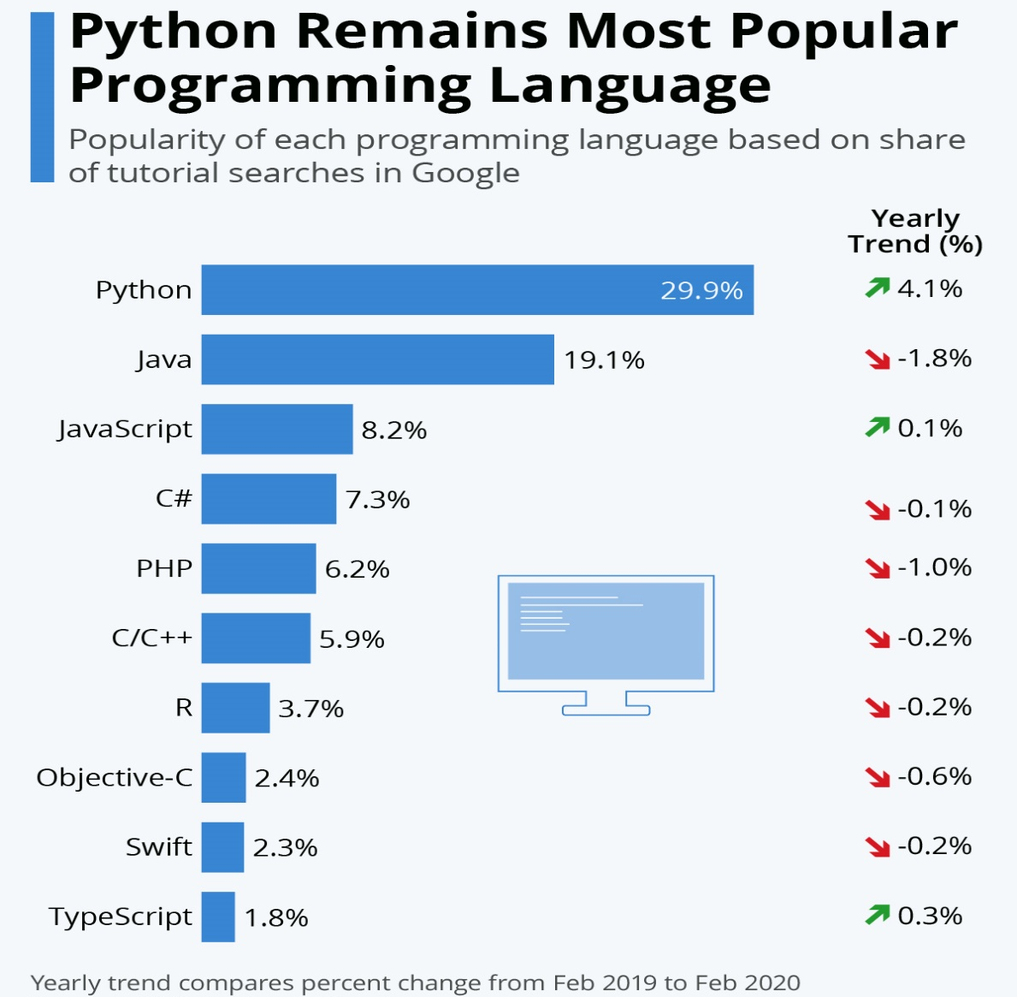
Survey About Programming language

Slide 8
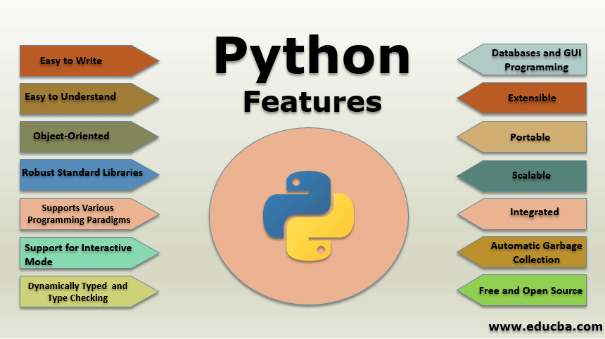

Slide 9
Why Python
Grammar, structure, or order of the coding.
Set of rules.
#include<(filename)>
import (filename)
If (2>1)
{
printf (“2 is High”) ;
}
If (2>1) :
print (‘2 is High’)
Void main()
{
Printf(“Hello World”);
}
print (‘Hello World’)

Slide 10
Why Python
Automatic memory management
int a = 4
a = 4
char ( )
a = “ 4 ”

Slide 11

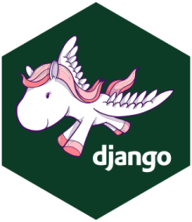
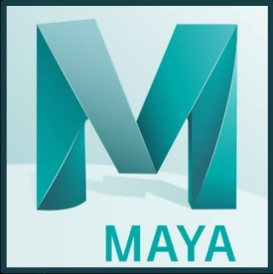
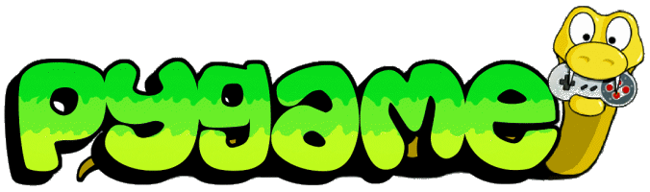

Why Python
General-Purpose
Wide variety of application domain

Slide 12
Installation
https://www.python.org/downloads/

Slide 13
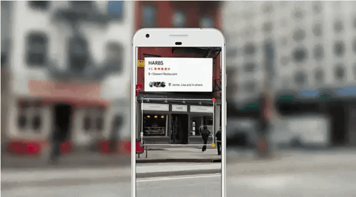

Why Python

Slide 14
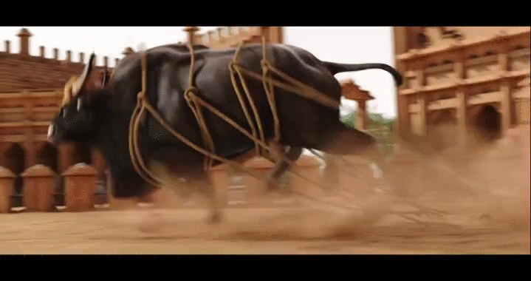

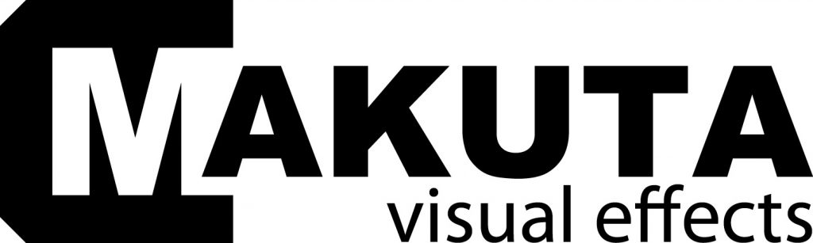
Why Python

Slide 15
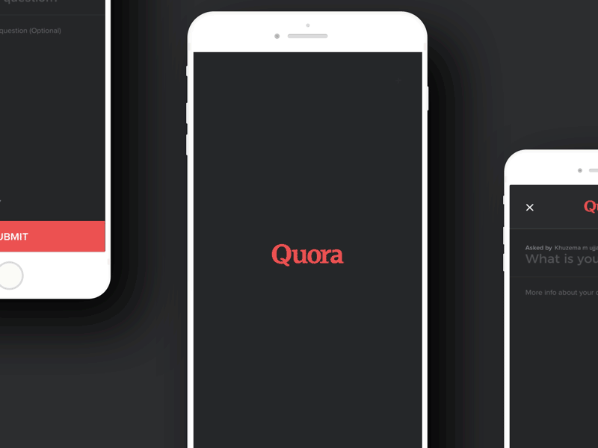
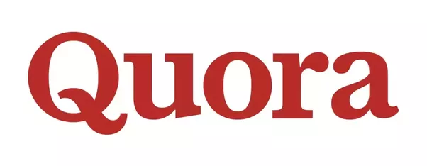
Why Python

Slide 16
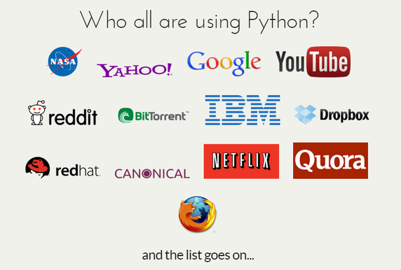

Slide 17
Python-Running
Modes
Interactive
Script

Slide 18
Ready For Hands On

Slide 19
Python Installation

Slide 20
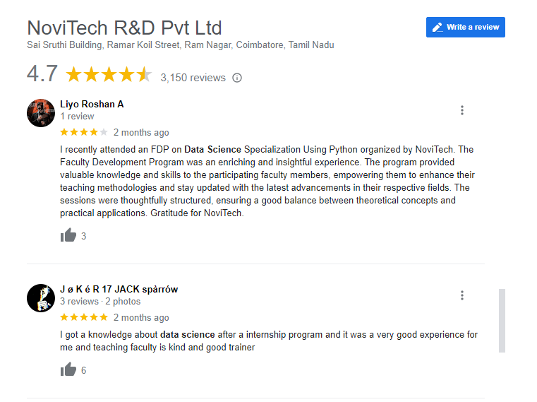
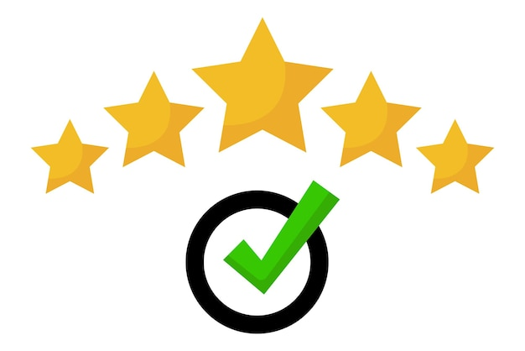
Google Review

Slide 21
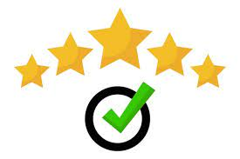



THANK YOU☺
NOVITECH COIMBATORE
novitechresearchanddevelopment

